Slide 1


Data Analytics Life Cycle,
Research, Citing and Referencing
Taufique Ahmed
Thanks to Graham Glanville
©CCT College Dublin 2022

Slide 2

Copyright Notice
The following material has been communicated to you by or on behalf of CCT College Dublin in accordance with the Copyright and Related Rights Act 2000 (the Act).
The material may be subject to copyright under the Act and any further reproduction, communication or distribution of this material must be in accordance with the Act.
Do not remove this notice

Slide 3
Data Science Life Cycle
Discovery
Data Preparation
Model Planning
Communicate Results
Operationalize
(S. Sumathi et al., 2022)

Slide 4
Data Science Life Cycle
Discovery
Data Preparation
Model Planning
Communicate Results
Operationalize
(S. Sumathi et al., 2022)

Slide 5
Data Science Life Cycle
Discovery
Data Preparation
Model Planning
Model Building
Communicate Results
Operationalize
(S. Sumathi et al., 2022)

Slide 6
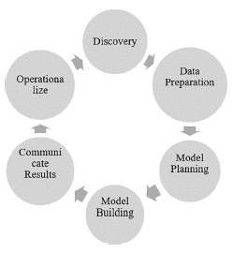
Data Science Life Cycle
(S. Sumathi et al., 2022)
Notes:
The question to answer in the data discovery phase is “Do we have enough information?”. Data discovery is the process of collecting and analyzing data from various sources to realize insight from hidden patterns and trends. It is the primary step in fully harnessing an organization’s data to tell critical business decisions. Through the data discovery process, data are gathered, combined, and analyzed during a sequence of steps. The goal is to form messy and scattered data clean, understandable, and user-friendly. The primary focus of this phase is to learn the business domain, including learning from past experiences and further assessing the resources required to support the project, such as human resources, time, technology, and data. The business problem has to be framed in such a way with the focus on the analytic challenge, and this would be addressed in subsequent Data Analytic Life Cycle phases. Finally, the initial hypotheses (IHs) have to be formulated to validate and begin learning the information. Understanding the domain in-depth for the given problem we are trying to find an answer to is critical. In a few situations, data scientists are required to possess advanced computational and quantitative knowledge such that the applications can be multi-disciplinary. These scientists are expected to possess an in-depth knowledge of the techniques, methods, and models for applying heuristics to different business and conceptual problems. Experts from domain areas with quantitative expertise will also partner with data scientists to address the gap between domain knowledge and analytical depth. While assessing the resources, there should be a focus on the available tools and technology used for the process and the types of systems required for interaction with subsequent phases. It is also required to have an evaluation concerning analytical facilities available within the organization.
Questions are as follows:
What would be the type of roles required for end-users of the model?
b. The current development model will drive success?
c. Are the roles available within the organization?
Such evaluation will help decide on the current implementation and future implementations on the type of data handling. In addition, it is necessary to validate whether the information available is sufficient to support the objectives of the current project, or whether data collection is required, whether the purchase of data from outside sources is required, or any extensions or transformations on existing data are required. Moreover, for successful project implementation, a good project team has a proper combination of subject matter experts (SMEs), domain experts, analytic team, customers, and the project management team. Also, it is required to assess the proportion of SMEs such that there is a clear focus on the depth and breadth of skills on the working team. Once the inventory for the project is decided concerning the team, tools, data, and technology, then another set of evaluations is done to decide on the resources, else additional resources are added. Once the interaction is complete with the stakeholder and sufficient knowledge is obtained on the domain, the business problem can be framed by considering experience. Later, the analytics problem is defined, and during this phase, the role of the stakeholders, their project requirements, their interests, and their criteria to evaluate the project. Since the analytical part of the project aims at a business perspective, it is necessary to address the weak points very clearly so that haphazard can be avoided while working on the project. Based on the number of participants and stakeholders, we must consider using the responsible, accountable consulted, and informed (RACI) matrix. This will give a clear picture of the expectation and participation from each stakeholder, set clear expectations with the participants, and avoid delays later when we need approvals from stakeholders, rather than the supervisor of the work product. The RACI matrix is a method in which the responsibilities are documented. These responsibilities include the role of a person in the project, whether the person fits rightly in the project, etc., RACI refers to the role of people within a project:

Slide 7
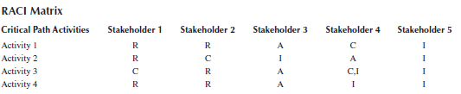
Data Science Life Cycle
Discovery
Before starting the project, having a strong command of the background of the project is essential. It’s essential to have all the questions clear at the start. Gather all the requirements needed during the project. A data scientist must have a question/answer session with clients for a better understanding of requirements. A quick review of the history of the company and project, whether a similar project has been done in the past for reference.
Responsible, Accountable, Consult and Inform
RACI Matrix
(S. Sumathi et al., 2022)
Notes:
• Responsible: Those individuals or groups responsible for doing the critical path activity and expected to complete the tasks actively.
• Accountable: Those individuals or groups who are answerable for a decision. In this case, only one accountable person/group is assigned to a given task to ensure clear ownership and accountability.
• Consult: Those individuals or groups who are the specific domain experts/SMEs will be in consultation throughout the project.
• Inform: Those individuals or groups who have to be kept informed whenever a decision or an action is taken.

Slide 8
Data Science Life Cycle
Data Preparation
This step plays a critical and time-consuming role in the life cycle; this phase acts as a filtration process of data. In this step, all the cleaning and elimination of missing attributes are done. Why is the phase time-consuming? When we talk about big data, it can be in terabytes or more than that. Cleaning a large amount of data requires hundreds of scenarios. Let’s take the example of variable “area,” which has the data type integer. All the records are in integer except one record, which is in decimal. The integer data type cannot contain a decimal value; here, you need to eliminate that particular record.
(S. Sumathi et al., 2022)

Slide 9
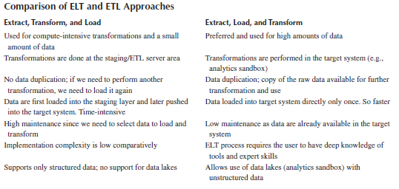
Data Science Life Cycle
Data Preparation
(S. Sumathi et al., 2022)

Slide 10
Data Science Life Cycle
Model Planning
In this phase, you need to select the ML model for your project, which algorithm needs to be applied, and select the mathematical approach which will give the best possible outcome.
Supervised Learning
Unsupervised Learning
Size of the Training set
Training time
The number of parameters
The number of features
Accuracy
(S. Sumathi et al., 2022)
Notes:
• Supervised learning: The answer to the question is specific, for example, what is the sal-ary of a 5-year-experienced ML engineer? The data are labeled, and this type of model predicts the outcome/future. Direct feedback is given to the model. Ground Truth (input) and Answer Key (output) are also given to the model.
• Unsupervised learning: The data are cumbersome and not labeled. The intention is to find the hidden patterns in the data. No feedback is given to the model.
Size of training set: We all know that when the training dataset is not enough, it always results in poor estimation. An over-constrained model on the insufficient training data-set will always end in underfitting; on the other hand, an under-constrained model will probably lead to overfitting the dataset; in both the cases, the outcome will turn to be poor performance. Thus, the size of the training dataset may be a factor that plays a significant role for us when deciding the algorithm of our choice. For a little training dataset, as the low-bias/high-variance classifiers (such as k-nearest neighbors) are likely to overfit the training dataset, the high-bias/low-variance classifiers are at an advantage over this.
Training time: Time taken to coach the model varies for every algorithm. This time corre-lates with the size of the dataset and the accuracy we are aiming for.
The number of parameters: Parameters are one of the foremost important factors in an honest-performing model. Therefore, the components like an error tolerance level and a complete number of iterations depend on the algorithm’s nature. Usually, the foremost number of trail and errors is needed to seek an honest combination within the algorithms that have an enormous number of parameters. Although having many parameters typically gives more versatility, the time taken to train the model using a particular algorithm and the same accuracy may be sensitive in obtaining just the right setup.
The number of features: Compared with the number of data points, the number of features of certain datasets may be quite large. We face the same situation when dealing with the Natural Language Processing (NLP) datasets, which are more textual datasets. Some learning algorithms can consume a longer training time when dealing with many features and make the work unrealistic. Some ML algorithms like support vector machines are especially well designed for this situation. These assumptions we make based on past expe-riences do not work for all situations, and we are required to have a better understanding of such algorithms to apply the best one for a specific problem.
Accuracy: The ML algorithms we use to make realistic decisions and greater accuracy on model results lead to better decisions. The expense of errors may be enormous, so we need to minimize that cost by improving the model’s accuracy. The accuracy needed will be distinct, depending on the requirement. The approximation is often sufficient, which can result in a massive decrease in processing time. However, approximate techniques are likely to result in overfitting of the training dataset.

Slide 11
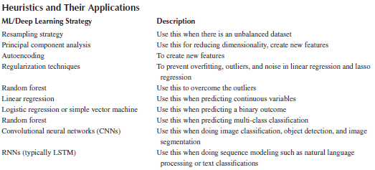
Data Science Life Cycle
Model Planning
(S. Sumathi et al., 2022)

Slide 12
Data Science Life Cycle
Model Building
Once the model is finalised and created just codes, the most commonly used language is Python. As soon as the project is ready, we deploy the system and share it with a customer. In this way, QA is done by the client itself. Any changes at the client end are urgently taken up and resolved.
(S. Sumathi et al., 2022)
Notes:
During these iterations and refinement of the model, document the answers to the questions below to access the model efficiency:
• Does the model look plausible and accurate on the test and validation data?
• Does the model output/behavior make sense to the domain experts and SMEs? In other words, does it look like the model is providing “the right answers” or answers that make sense in the business context?
• Does the model accurate enough to meet the success criteria? (efficiency, performance, and other key performance matrix defined in phase1)
• Does the model avoid the kind of mistakes it needs to avoid? Depending on the context, false positives may be more serious or less serious than false negatives, for instance.
• Do the parameter values of the fitted model make sense in the context of the business domain?
• Do we need more data or more inputs? Do we need to transform or eliminate any of the inputs?
• Do we need a different form of the model? Then, we will need to go back to the ML model planning phase (Phase 3) and revise the modeling approach.

Slide 13
Data Science Life Cycle
Communicate Results
The client should have a clearer understanding of the model and result, which is very difficult as the client has no understanding of data science. Therefore, model interfaces should be transparent and interpretable as it will become easier for the client to absorb them.
Operationalize
The final step is where documentation and maintenance of the project are done. Documentation will help the client to understand the project and run it efficiently.
(S. Sumathi et al., 2022)
Notes:
Evaluate the models’ outcomes.
• Do the findings appear to be statistically significant and consistent? If that’s the case, what characteristics/attributes of the outcomes stand out? If not, what changes do we need to make to the model to refine and iterate it to make it more sustainable?
• Which facts/details surprised you, and which were consistent with your arriving hypotheses from Phase 1? Correlating the confirmed outcomes to the ideas we formulated early on usually results in additional ideas and insights that would have been missed if we hadn’t taken the effort to formulate IHs early on.
What data have been observed as a result of the analytics?
• What are the most important discoveries from those?
• Do these discoveries have any commercial value or significance? We may need to spend time quantifying the business implications of the results to help prepare for the presentation, depending on what emerged as a consequence of the model.
In this phase, we’ll evaluate the work’s benefits and set up a pilot so we may launch the work in a controlled manner before expanding it to a larger enterprise or ecosystem of consumers. We scored the model in the sandbox in step 4, and most analytics approaches implementing new analytical methods or models in a production environment for the first time in Phase 6. Therefore, instead of deploying this on a large scale, we advocate starting with a small pilot rollout. This approach will allow us to limit the risk relative to full-enterprise-wide deployment, learn about the performance and related constraints on a small scale, and make fine-tune adjustments before a full deployment.

Slide 14
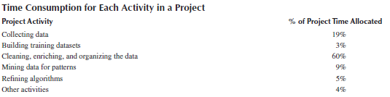
Data Science Life Cycle
(S. Sumathi et al., 2022)

Slide 15
Research

Slide 16
Firstly….
Academic Research v Market Research
Peer Reviewed
NOT Peer Reviewed
Graham Glanville

Slide 17
The influence of research
Individual Qualified as a journalist
First Job at the Dublin Herald
The individual writes an article entitled “Starbucks is destroying small coffee shops in Dublin”
The individual writes an article entitled “Starbucks is destroying small coffee shops in Dublin”- published online..
5000 word essay on why Starbucks is the enemy of coffee shops in Dublin
Student
Asked to do an Academic Business Project in College
Performs research on the internet and finds this…
Chooses to write about Starbucks
Graham Glanville

Slide 18
How do we know what we know and why do we do what we do?
Personal Experience (Sensory Experience)
  Our personal experiences are limited
  We may be mistaken in our observations
  We may fail to see things clearly because of our biases
Graham Glanville

Slide 19
How do we know what we know and why do we do what we do?
Tradition (Agreement with Others)
  Advice, rules, and approaches to handling problems are passed from year to year and accepted as truth
  Reliance on tradition eliminates the need to search for knowledge, makes accepting new knowledge difficult, and mitigates our desire to question existing practice.
Graham Glanville

Slide 20
How do we know what we know and why do we do what we do?
Authority (Expert Opinion)
  Authorities can be wrong, and the public has a tendency to accept as fact what are actually opinions.
  Science “Best effort”
Graham Glanville

Slide 21
The Research Process
Selecting and defining the problem
Accumulating pertinent knowledge and information
Developing specific objectives
Designing the study, collecting and analyzing data
Interpreting data
Preparing the research report
Graham Glanville

Slide 22
Why Conduct Research?
To better understand various phenomena
To disprove fraudulent claims
To improve education or your specific discipline
Graham Glanville

Slide 23
What Is Research?
  The Higher Education Authority (HEA) defined research as:
    ‘original investigation undertaken in order to gain knowledge and understanding’.
    Three key terms in this definition are worth exploring:
      Original
      Gain
      Knowledge
Graham Glanville

Slide 24
Originality
  … doing or producing something that has not been done before. Simplistic! How does it relate to Applied Technology Group Projects?
  Cryer (1996) offers four ways in which a project may be original:
    Tools, techniques, procedures and methods:
      New tools and techniques applied to alternative problems.
      Trying new procedures and methods where they have not been applied before.
Graham Glanville

Slide 25
Knowledge
  Knowledge may be discussed relative to data, information, and wisdom. Post and Anderson (1997) describe these as:
    Data: factual elements that describe objects or events.
    Information: data that has been processed in order to provide some insight into their meaning.
    Knowledge: a higher level of understanding.
    Wisdom: an ability to put knowledge into practice. Apply skills and experiences to create new knowledge.
Post G.V. and Anderson D.L. (1997) Management Information Systems: Solving Business Problems with Information Technology. London. Irwin

Slide 26
What Is Research?
  Research is not intelligence gathering – ‘fact gathering’
  Facts are used to answer ‘what’ questions, for example:
    What is the impact on competitive advantage of a misalignment between IT strategy and business strategy?
Graham Glanville

Slide 27
What Is Research?
  Research looks for ‘explanations, relationships, comparisons, predictions, generalisations and theories’.
  In other words, research addresses the ‘why’ question, for example:
    Why is an organisation’s competitive advantage so dependent on close alignment of an organisation’s IT strategy and business strategy?
Phillips, E.M. and Pugh, D.S. (1994) How to get a PhD. (2nd Edition). Milton Keynes. Open University Press

Slide 28
What Is Research
  Research is not, therefore, undertaken in an informal fashion.
  It should be a planned activity, which is pursued in a considered way.
  Dawson (2005) draws all this together by succinctly stating:
    ‘Research is a considered activity which aims to make an original contribution to knowledge’
Sharp, J.A. and Howard, K. (1996) The Management of a Student Project (2nd Edition). Aldershot. Gower.
Dawson, C.W. (2005) Projects in Computing and Information Systems: A Students Guide, Prentice-Hall

Slide 29
Theory
  In research there is a further category to consider: Theory.
    Gill and Thompson (1997) define theory as:
      ‘a formulation regarding the cause and effect relationship between two or more variables, which may or may not have been tested’.
    Theory therefore has a specific meaning. It refers to a situation where:
      if variable ‘A’ is introduced variable ‘B’ will be the consequence.
    Where, A is the ‘cause’ and B the ‘effect’
Gill, J. and Johnson, P. (1997) Research Methods for Managers (2nd edition), London, Paul Chapman.

Slide 30
Theory
  Saunders et al (2006) note that ‘every purposive decision we take is based on theory: that certain consequences will flow from a decision.’
  As such, theory is rooted in our everyday lives, e.g., management decisions are implicitly theory dependent: we will do A because we want B to happen.
  Kerlinger (1973) notes that the purpose of examining relationships between two or more variables is to explain and predict these relationships.
Saunders, M. Lewis, P. and Thornhill, A. (2006) Research Methods for Business Students (4th Edition) London. FT Prentice-Hall.
Kerlinger, F. (1973) Foundations of Behavioural Research (2nd Edition) New York, Holt Rinehart and Winston.

Slide 31
Theory
  Gill and Thompson (1997) makes this explicit by stating:
    ‘… it is also evident that if we have the expectation that by doing A, B will happen, then by manipulating the occurrence of A we can begin to predict and influence the occurrence of B. In other words, theory is clearly enmeshed in practice since explanation enables prediction which in turn enables control.’
Gill, J. and Johnson, P. (1997) Research Methods for Managers (2nd edition), London, Paul Chapman.

Slide 32
Research Process
Orna and Stevens (1995) offer this model of the ‘real’ research process:
Define the search
World knowledge
Search/Investigate
Discover
Contribution to knowledge
Communicate what you have discovered
Adapted from Orna, E. and Stevens, G. (1995) Managing Information for Research, Buckingham. Open University Press

Slide 33
Research Process
  The Orna and Stevens model includes two views of the research process:
    Circulatory, which recognises that any research is part of a continuous cycle of discovery and investigation.
  In the model, this commences with ‘define the search’ and seeks to answer the following questions:
    What am I looking for?
    Why am I looking for it?
    How shall I set about it?
    Where shall I start looking?
Graham Glanville

Slide 34
Deductive Approach
Deduction
Moving from theory to data
Common with natural sciences
A highly structured approach
Explain causal relationships between variables
Select samples of sufficient size to generalise conclusions
Adapted from: Saunders, M. Lewis, P. and Thornhill, A. (2006) Research Methods for Business Students (4th Edition) London. FT Prentice-Hall.

Slide 35
Deductive Approach
To Collis and Hussey (2003), deduction is the dominant research approach in the natural sciences, where laws present the basis of explanation, allow the anticipation of events, predict their occurrence and therefore permit them to be controlled.
Collis, J and Hussey, R., (2003), Business research: A practical guide for undergraduate and postgraduate students, 2nd Edition. Basingstoke. McMillan

Slide 36
Research Process
  And Robson (1993) proposes sequential five stages of deductive research
    Deducing a hypothesis from the theory
    Expressing the hypothesis in operational terms
    Testing the operational hypothesis
    Examining the specific outcome of the inquiry
    If necessary, modifying the theory. And possibly repeating the cycle.
Robson, C. (2003) Real World Research. Oxford. Blackwell.

Slide 37
CITING AND REFERENCING

Slide 38
CITING AND REFERENCING
Overview of when and why we need to reference
Guidelines for referencing on this programme
Tips on introducing references into the text
Paraphrasing and avoiding plagiarism
Graham Glanville

Slide 39
Why / When Reference?
Why do you have to reference?
  To provide evidence to support ideas that you draw upon in your writing
  To credit another writer
  To allow reader to follow-up the reference
When should you reference?
  When draw upon idea that is not your own, e.g.
    Point of view/argument
    Statistical information
    Published evidence
Graham Glanville

Slide 40
CITING AND REFERENCING
Without references ideas lack credibility, e.g.
  Some health professionals burn out due to the emotional strain of the job
Compare this with:
  Steele (2016) explains that due to the client-centred nature of healthcare, service providers might become emotionally drained
Graham Glanville

Slide 41
Typical sources of references
Main sources are:
Books
Journal articles
Electronic databases
What about the internet?
  May not be reliable, look for author name, contact details,
date of publication
Graham Glanville

Slide 42
CCT Citation Guidelines
There are different systems for referencing
CCT generally uses the Harvard system of referencing
Always follow CCT or Lecturer specific guidelines; don’t follow other guidelines (e.g. others found on internet)
Don’t try to learn it; sit it in front of you when writing – practice makes perfect!
Graham Glanville

Slide 43
Referencing components
There are 2 components to a reference:
  In text citation, e.g. (HETAC, 2019)
  Full reference details (at the back) – e.g.
  HETAC (2019). Education for the Future. Dublin: HETAC.
Graham Glanville

Slide 44
Text citations
Give the author(s) surname and publication year in the text of your work and the full reference at the back.
1 author: surname and date (Anderson, 2005)
2 authors: surnames and date (Anderson & Smith, 2005)
  If no brackets use ‘and’ rather than ‘&’ e.g: Anderson and Smith (2005) reported that….
Graham Glanville

Slide 45
Text citations
If more than 2 authors use ‘et al’ e.g.: (Anderson et al, 2005)
If quote word for word, need to give the page no. e.g:
Byrne, Smith and O’Brien (2005, p.376)
state that;
  “every student in a classroom environment has exactly the same opportunity to learn and retain the same amount of information .”
Graham Glanville

Slide 46

A few things to remember...
If no name appears on the website article, cite the organisation, e.g. (Irish Government, 2009)
Don’t quote big sections unless you can’t put in your own words – why?
  Looks like you don’t understand what author is saying
Graham Glanville

Slide 47
Weaving references into the text
Some examples:
As Smith (2009) argued….
Smith and Bloggs (2008) suggested that….
One researcher (Smith, 2015) argued that….
Other authors have agreed with this view (Anderson & Bloggs, 2003; Smith, 2005)
Smith (2007) supports this, stating that….
Further studies have shown that….(Anderson & Baker, 2002; Smith & Bloggs, 2008)
Multiple sources should be listed in chronological order and separated by semi-colons
Graham Glanville

Slide 48

Useful words for reporting
Examples of verbs you can use to report the views of others:
assert, claim, consider, contend, declare, demonstrate, explain, found, report, show, state, suggest, surmise, warn
NB: Consider carefully what words you use – some words have stronger implications than others
Graham Glanville

Slide 49
Plagiarism
What is plagiarism?
  The unacknowledged use of another’s work as if it were your own
Much of plagiarism at CCT is not deliberate cheating; it tends to be a failure to reference and quote properly.
Considered a very serious offence with penalties. For more info watch the Academic Standards Board information video on Moodle.
We use Copyleaks – so you can check your work before turning in!
Graham Glanville

Slide 50
Avoiding plagiarism - paraphrasing
Make sure you paraphrase (put author’s ideas in your own words), e.g.
Original: In the first year of life, infants form an attachment – a deep, affectionate, close and enduring relationship – with parents (Bowlby, 1973).
Paraphrased: The strong bonds or ‘attachments’ that infants develop with their parents in the first year of life can be considered to be deep and durable (Bowlby, 1973).
NB: Be very careful not to change the meaning of the original text
Graham Glanville

Slide 51
Be confident – put the text in your own words
Original: First impressions are difficult to change and typically have a long-lasting influence on how one person reacts to another (Clarke, 2010)
Paraphrased: According to Clarke (2010), once first impressions are formed, they cannot be altered easily and often have an enduring effect on how individuals interact with each other.
Graham Glanville

Slide 52
Reference list
Positioned at back of your essay or report (books or articles will often also have a reference list at the back)
Reference list contains ALL details of the sources you have used
Follow the Harvard Citation Guide very carefully
References should be presented in alphabetical order with as much detail as possible
Graham Glanville

Slide 53
Constructing a reference list: the rules
Book: Smith, P. (2019). Living in Dublin, 3rd ed. Dublin: Longman.
Journal article: Shrewsbury, M. (2011) The similarities in humans and non human primates, Journal of Anatomy, vol. 202, no. 4, p.51-59.
Graham Glanville

Slide 54
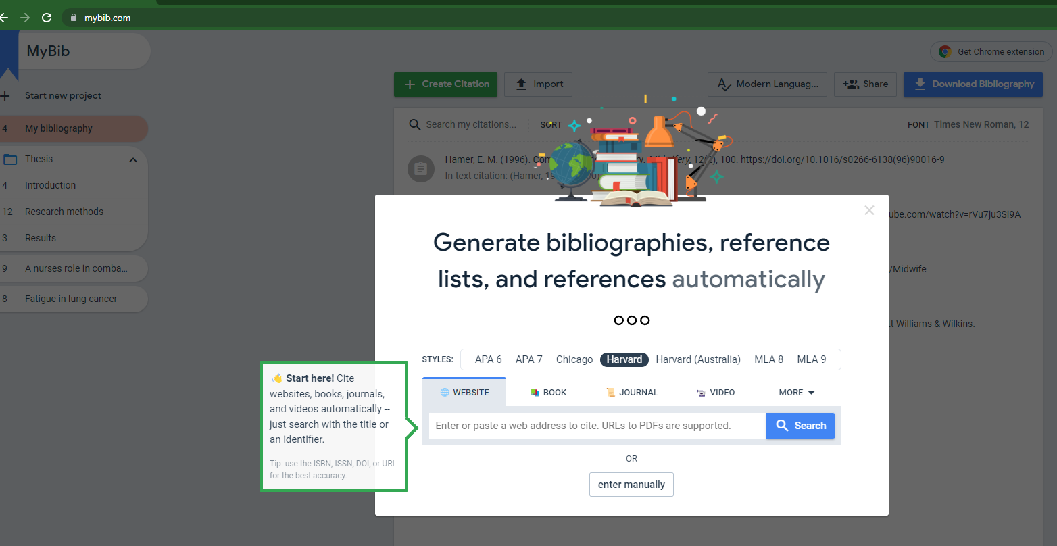
MyBib.com

Slide 55
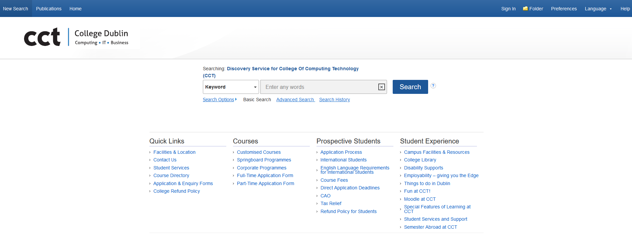
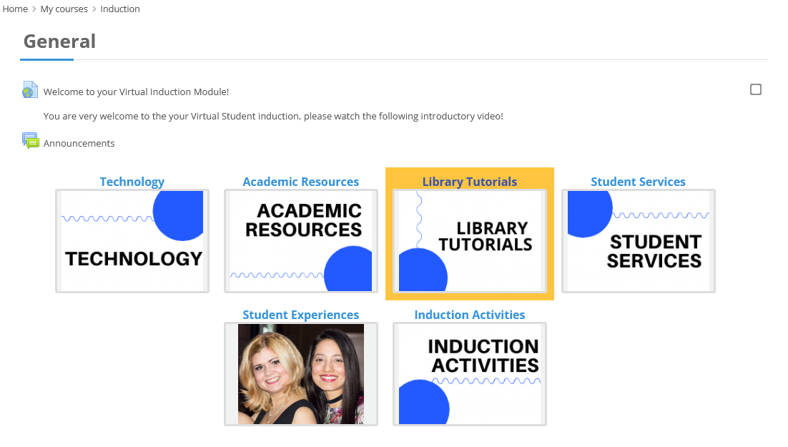
CCT Library

Slide 56


